Slide 1

Control Structures and Loops
Prof. Darrell Long
CSE 13S
Edsger W. Dijkstra

Slide 2
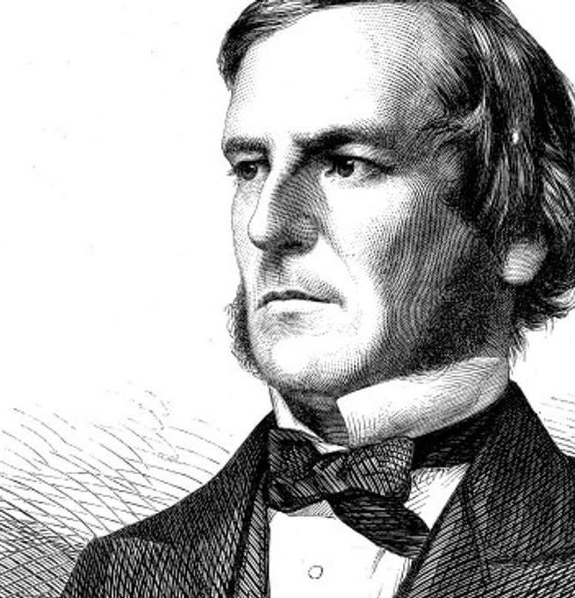

Boolean Algebra
Sought to set mathematics on a logical foundation.
Boolean logic has two values: true and false.
There are three basic operators:
∧ called and, also called conjunction (&& in C),
∨ called or, also called disjunction (|| in C), and
¬ called not, also called negation (! in C).
We will use true $=1$ and false $=0$.
George Boole

Slide 3

And (also called Conjunction)
Algebraic properties:
$A∧\left(B∧C\right)=\left(A∧B\right)∧C$
$A∧B=B∧A$
$A∧\left(B∨C\right)=\left(A∧B\right)∨(A∧C)$
$A∧1=A$
$A∧0=0$
$A∧A=A$
∧ (and) | T | F
T | T | F
F | F | F

Slide 4

Or (also called Inclusive-or or Disjunction)
Algebraic properties:
$A∨\left(B∨C\right)=\left(A∨B\right)∨C$
$A∨B=B∨A$
$A∨\left(B∧C\right)=\left(A∨B\right)∧(A∨C)$
$A∨0=A$
$A∨1=1$
$A∨A=A$
∨ (or) | T | F
T | T | T
F | T | F

Slide 5

Not (also called Negation)
Algebraic properties:
$A∧¬A=0$
$A∨¬A=1$
$¬\left(¬A\right)=A$
DeMorgan’s Law:
$¬\left(A∨B\right)=¬A∧¬B$
$¬\left(A∧B\right)=¬A∨¬B$
¬ (not)
T | F
F | T

Slide 6

Exclusive-or
$A⊕B=\left(A∨B\right)∧¬(A∧B)$
$A⊕B=\left(A∧¬B\right)∨(¬A∧B)$
Some algebraic properties:
$A⊕A =0$
$A⊕0=A$
$A⊕1=¬A$
$A⊕\left(B⊕C\right)=\left(A⊕B\right)⊕C$
⊕ (Xor) | T | F
T | F | T
F | T | F

Slide 7
Logical Operators
< | Less than
<= | Less than or equal
== | Equal
!= | Not equal
> | Greater than
>= | Greater than or equal

Slide 8
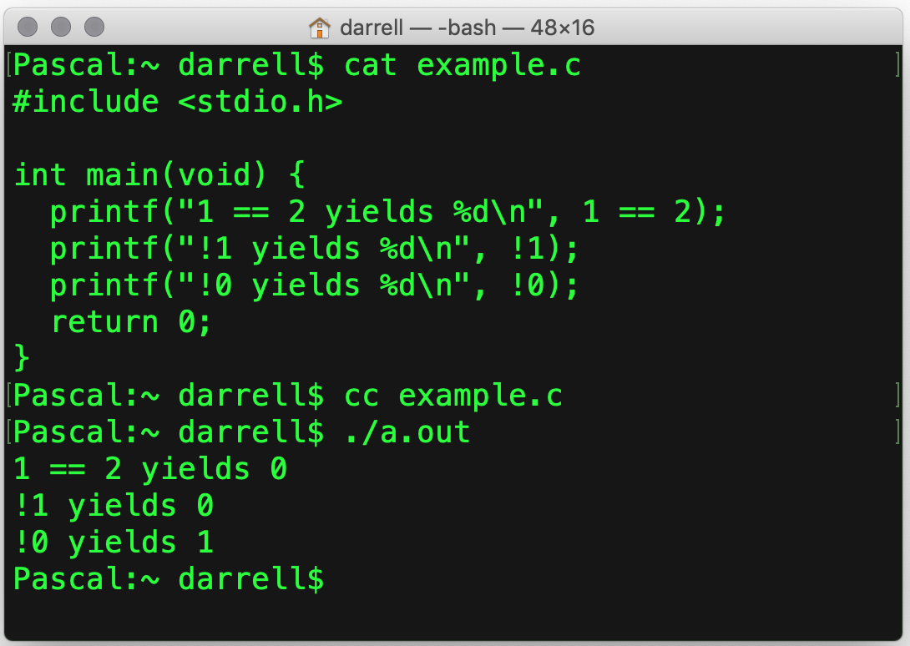
True and False in C
In C, zero (0) is false.
All that is not false is true.
Logical expressions have type int.
You can have true and false if you:
#include <stdbool.h>

Slide 9
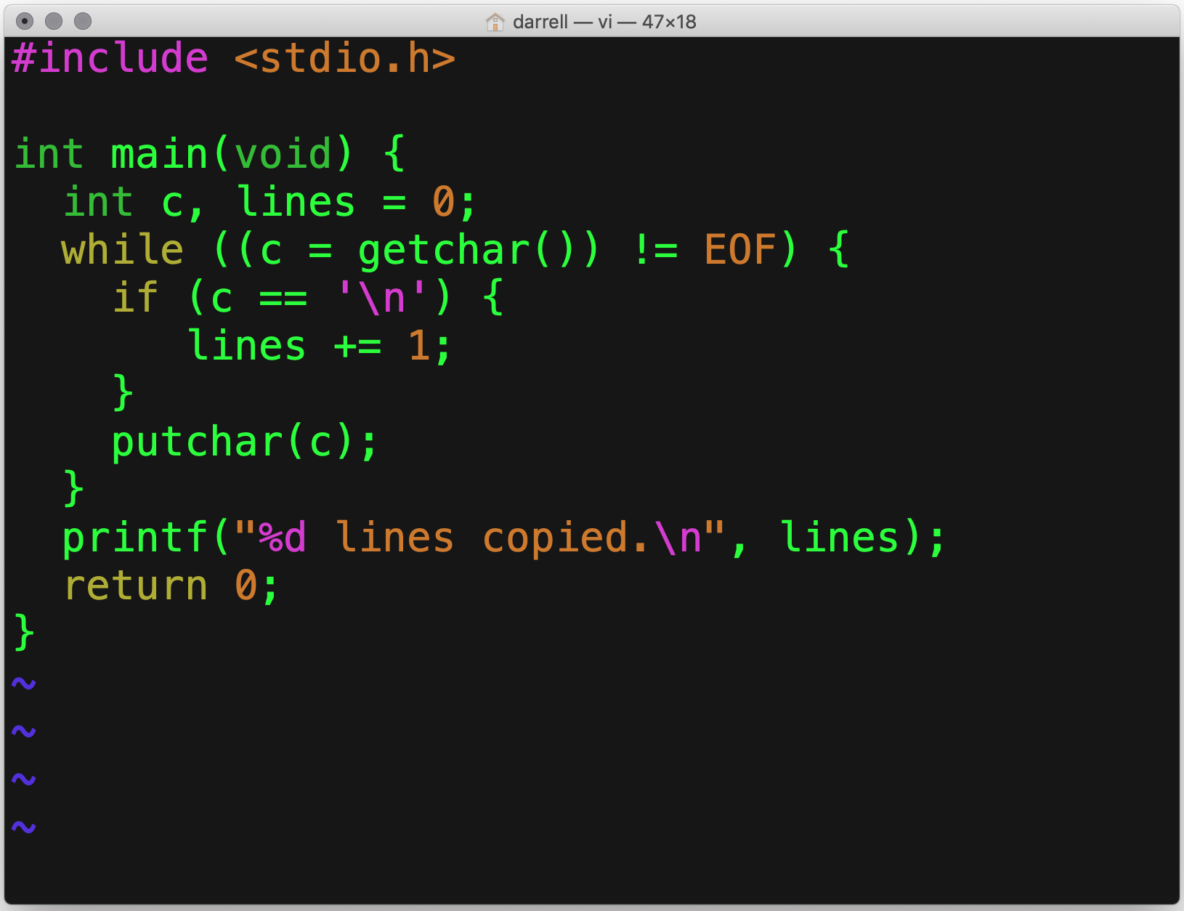
if ()
if executes the next statement if the Boolean expression is true.
Even through {} are not required for a single statement, always use them.
Why?
It avoids errors when adding statements.

Slide 10
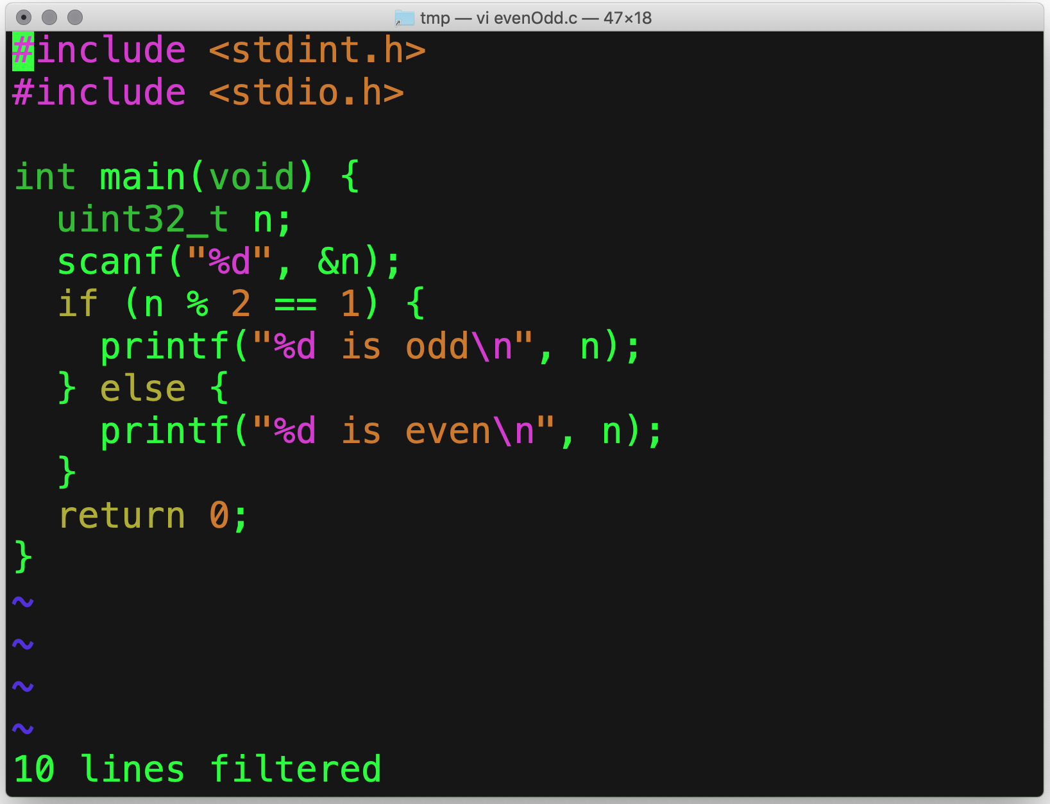
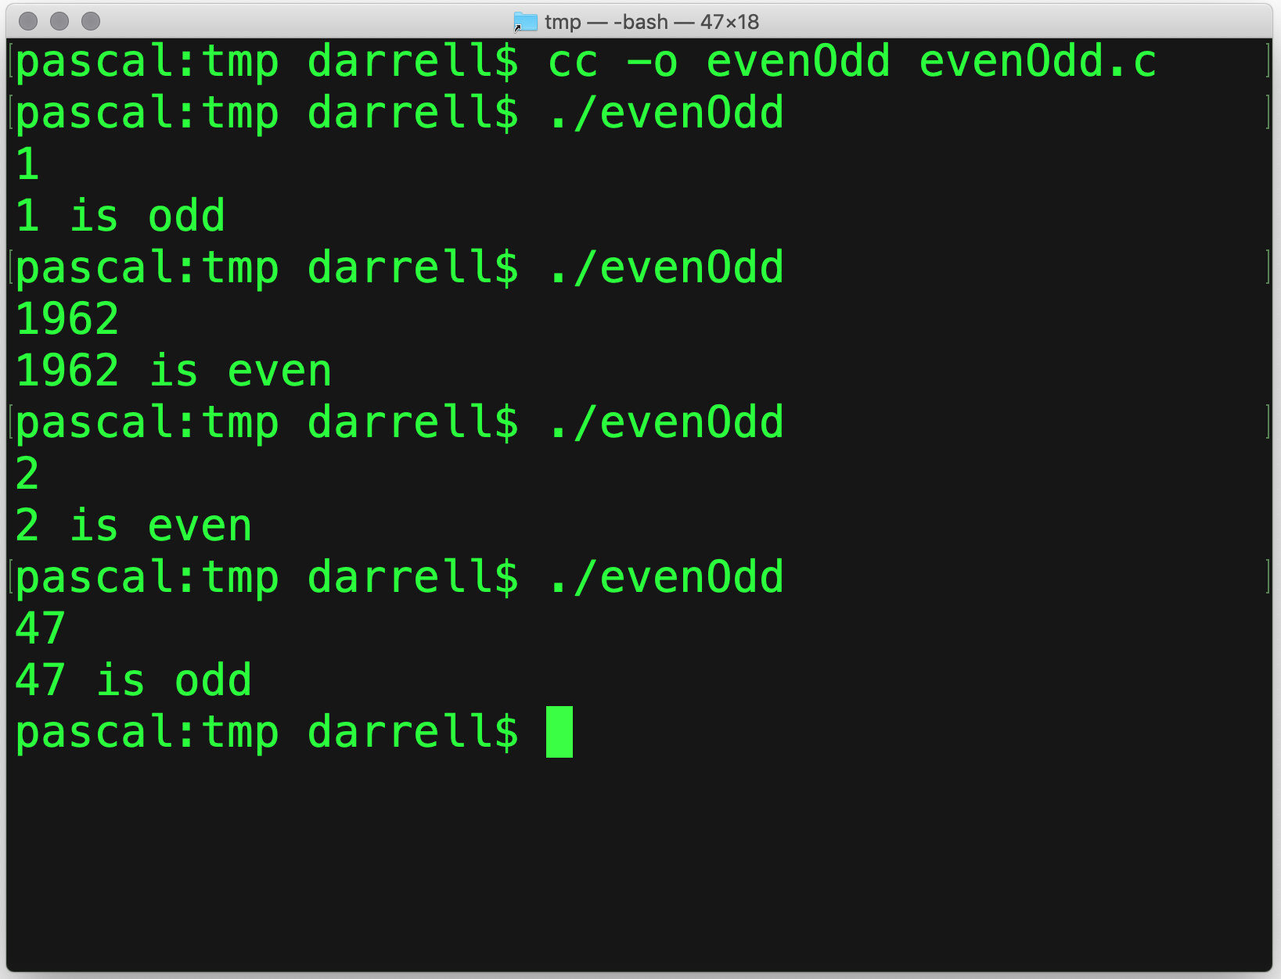
if () { … } else { … }
Read a number
True
False

Slide 11
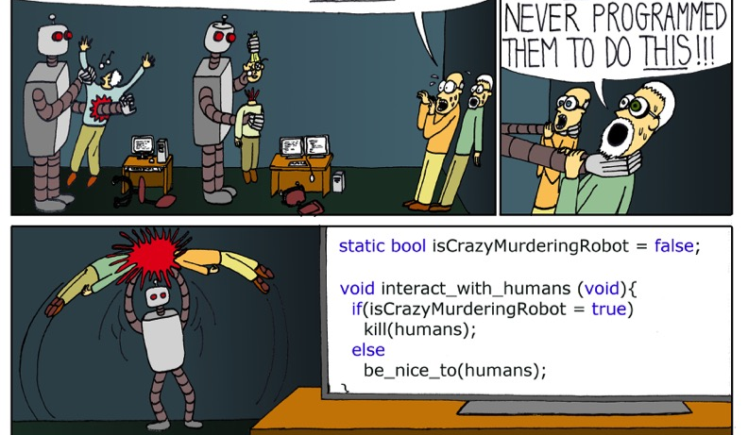

= $≠$ ==
(x = 17) is always true.
What?!?
Assignment (=)
is not the same as
Equality (==)
Oops!

Slide 12
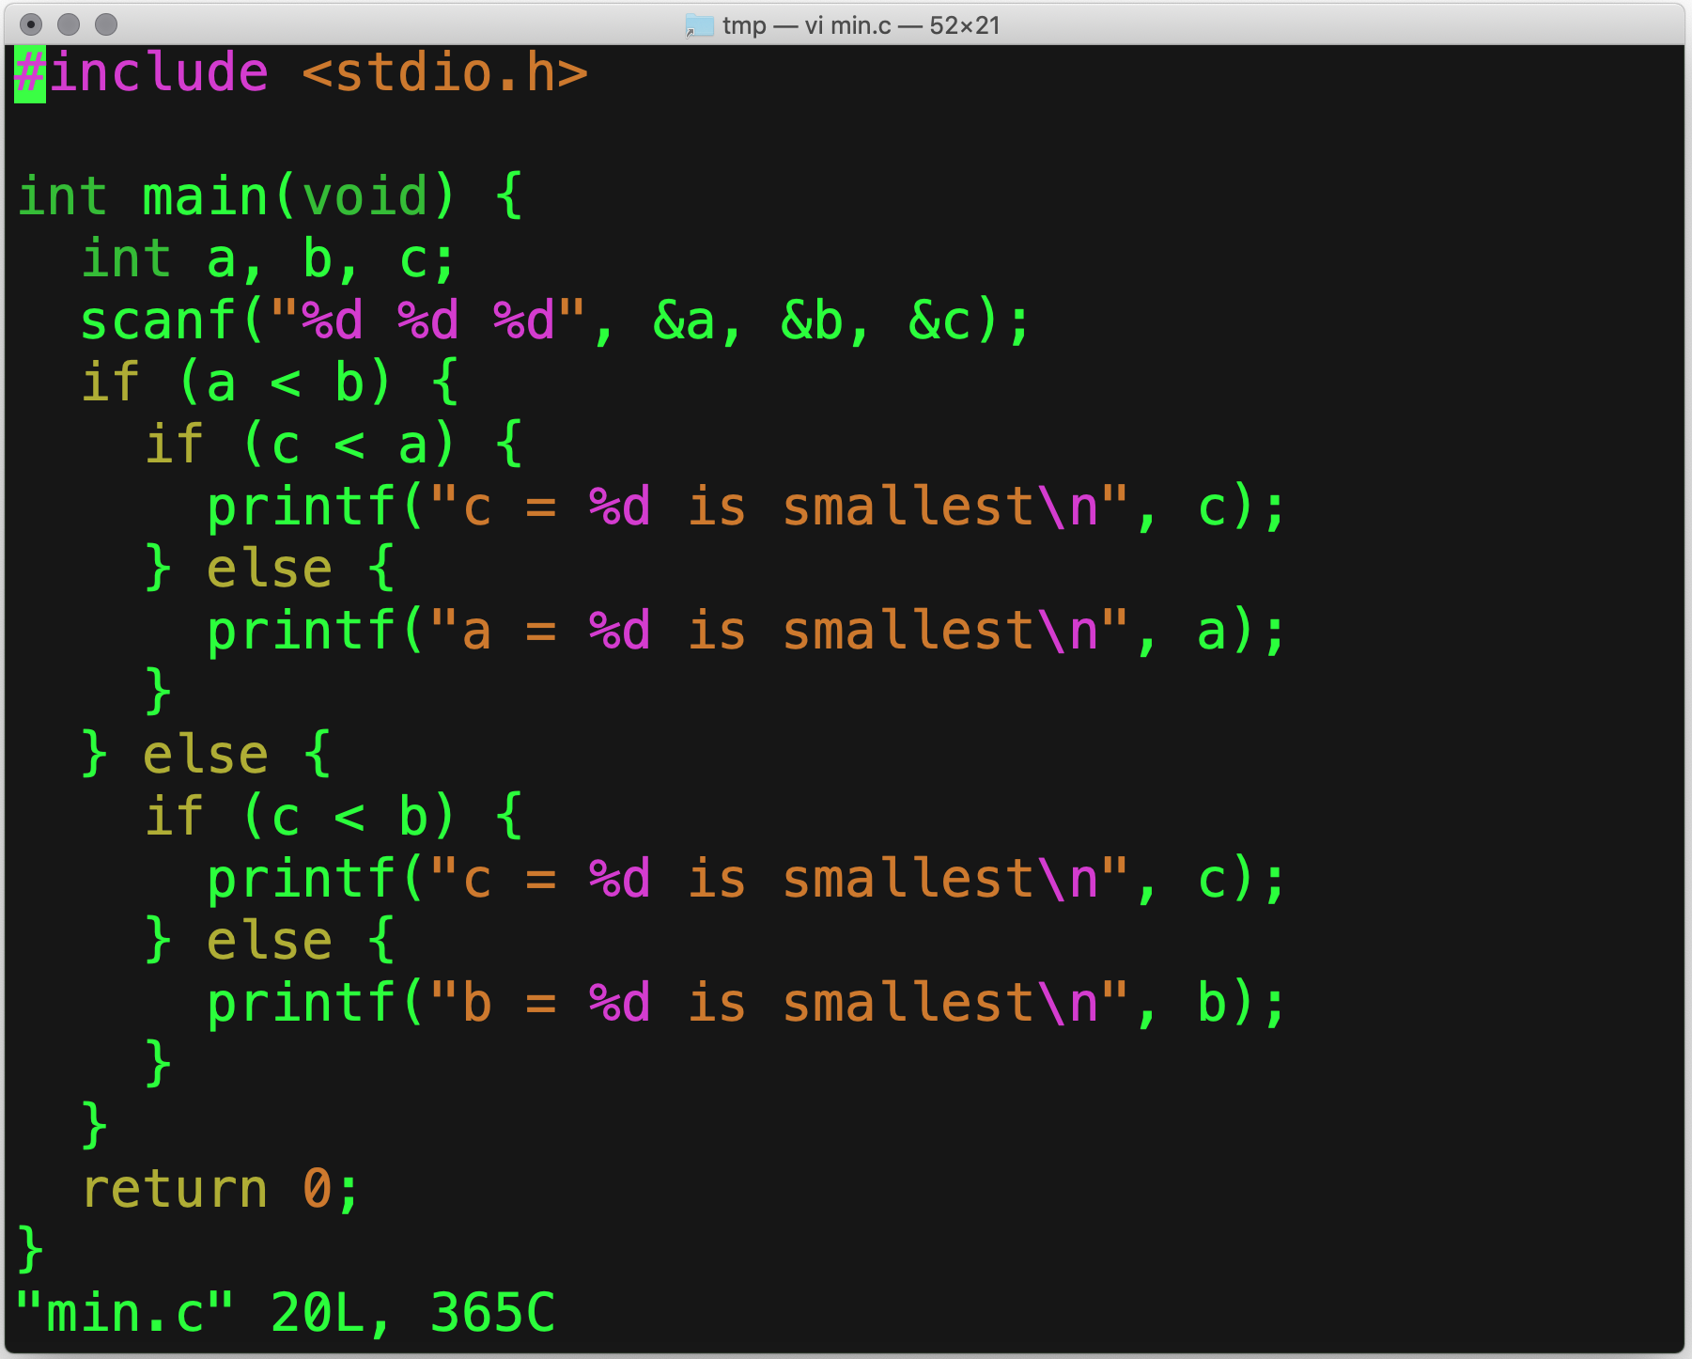
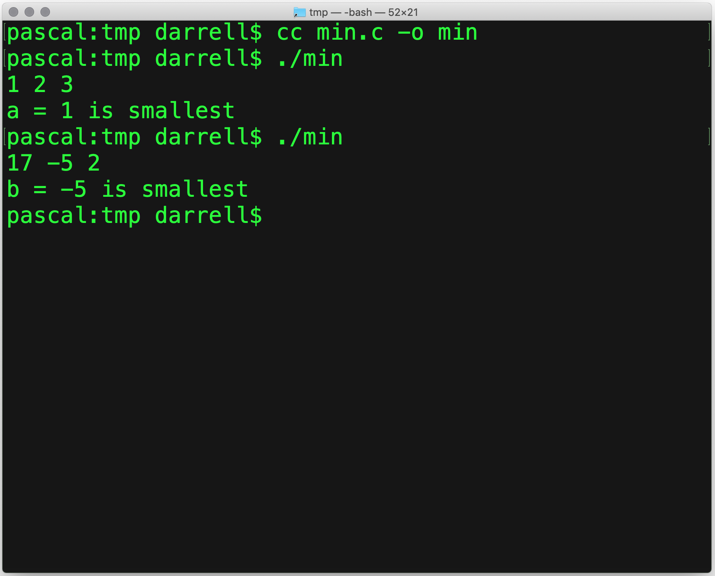
Nested if ()

Slide 13
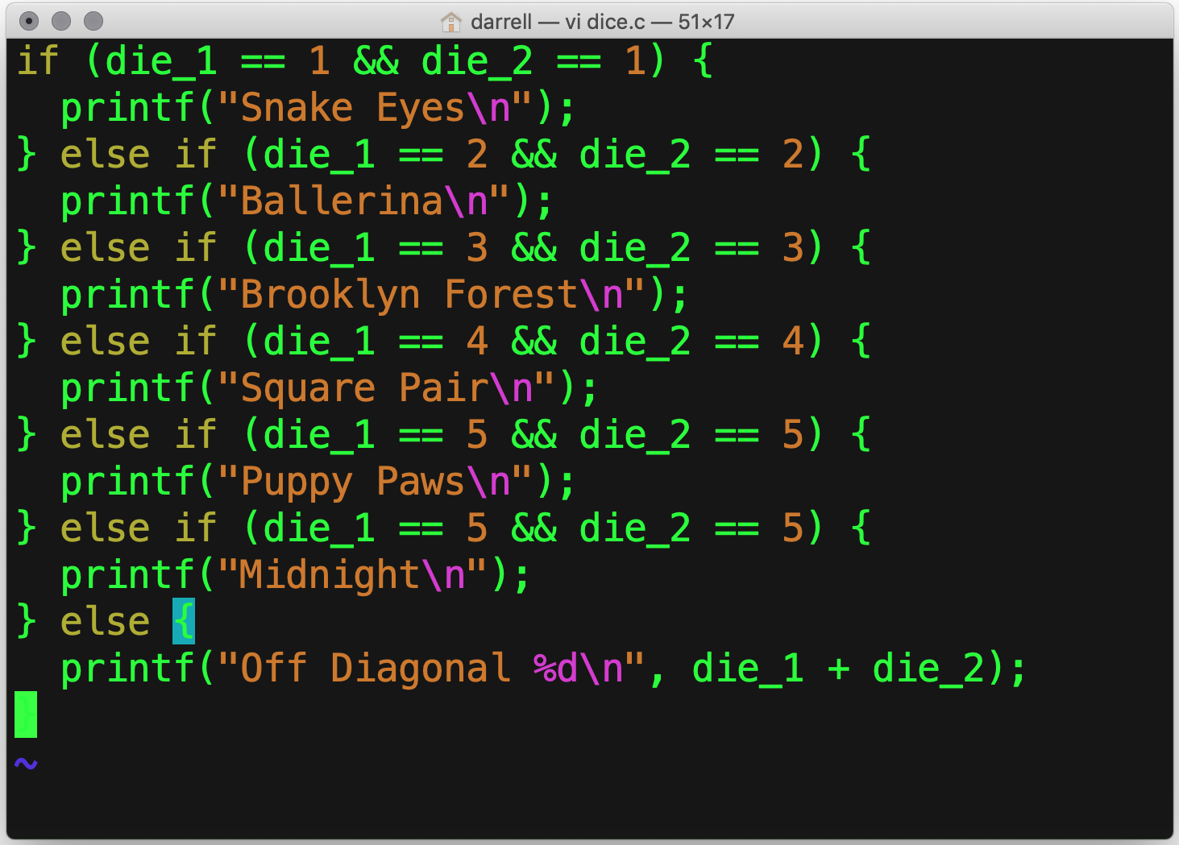
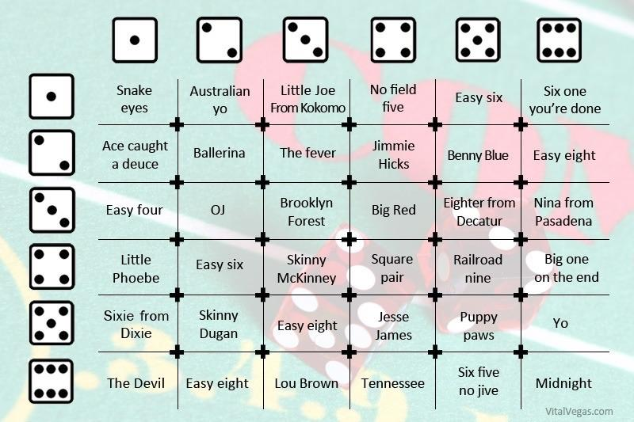
if () { … } else if () { … } … else { … }

Slide 14
Boolean Operators
&& | Boolean “and” (∧)
|| | Boolean “or” (∨)
! | Boolean “not” (¬)

Slide 15
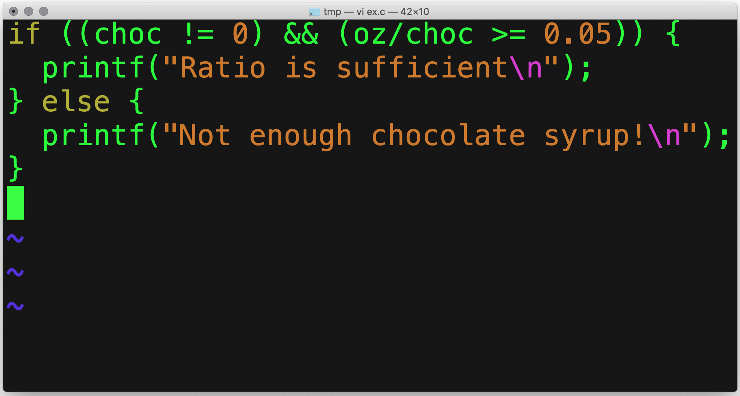
Short-circuit Evaluation
false && anything is false
true || anything is true
Stop evaluating as soon as we know the result.
Suppose we evaluated the entire expression:
We would be dividing by zero.
We could follow a null pointer.
More on that later.
Only do this if the denominator is not zero!

Slide 16
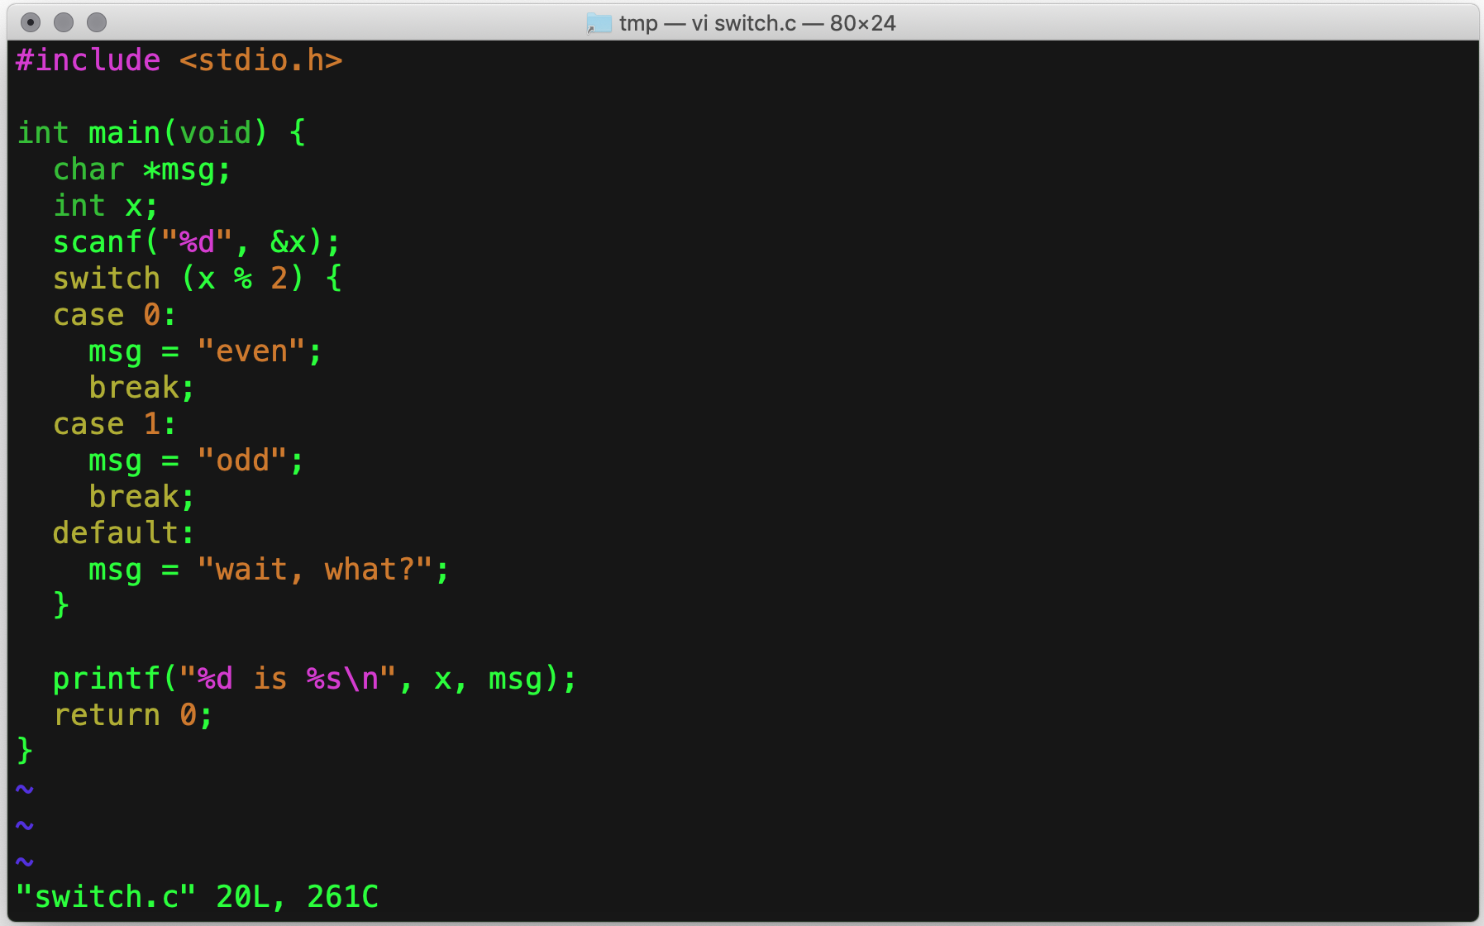
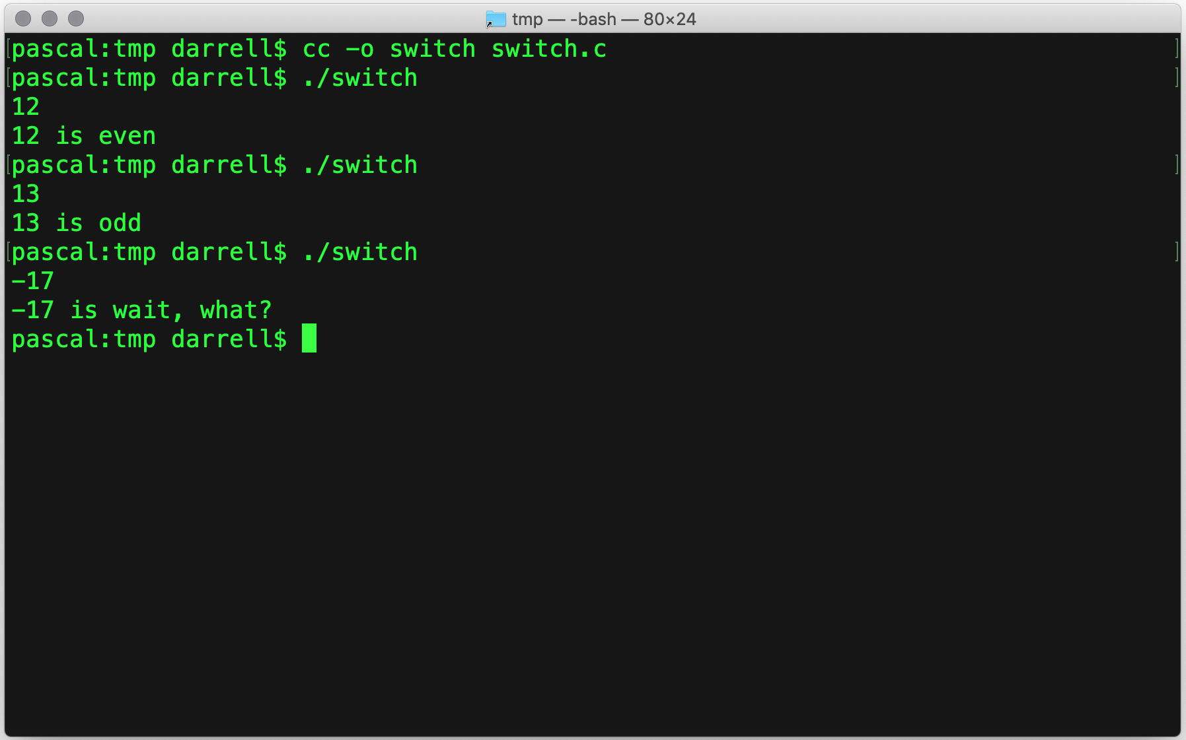
switch ()

Slide 17
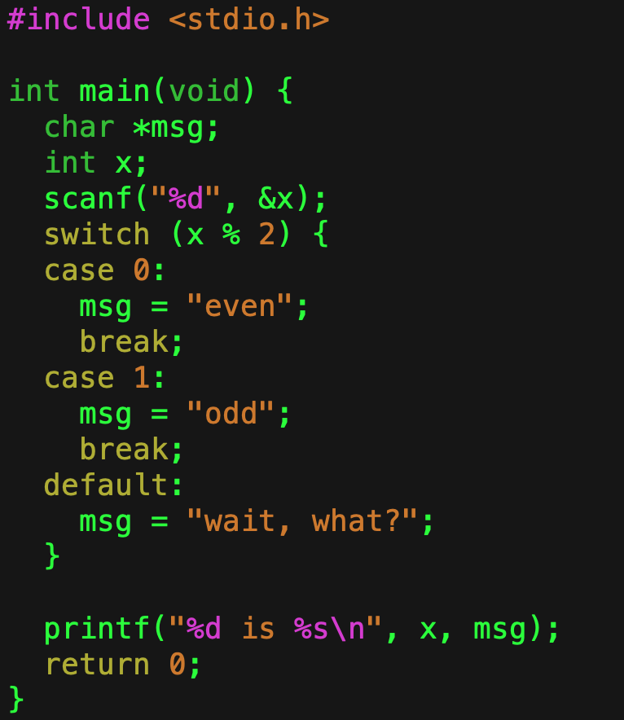
switch ()
If x % 2 == 0
Allows you to select among a fixed set of alternatives.
If none of them are present, then default is chosen.
Use break to skip to the end
If you forget, it will fall through to the next case.
If x % 2 == 1
Skip to the end

Slide 18
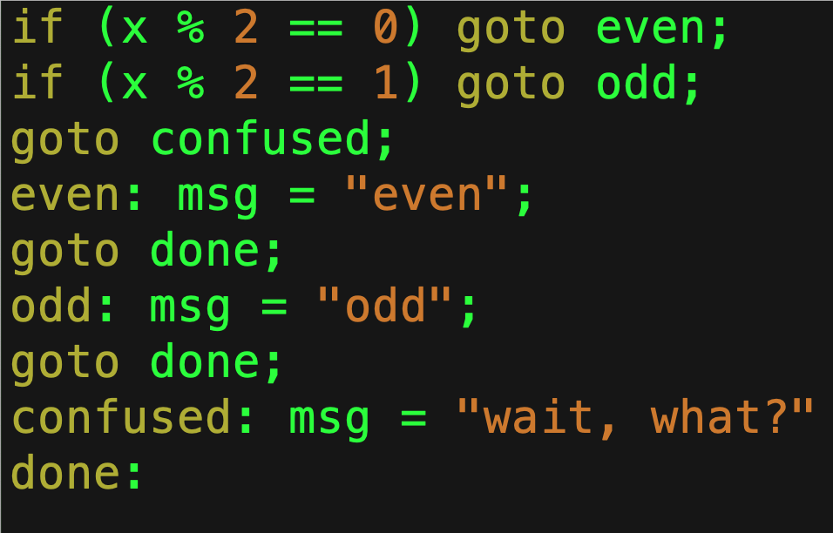
Equivalent goto Code
Like break

Slide 19
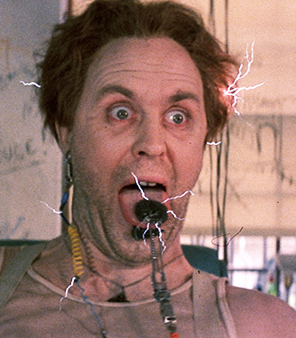
What is wrong with goto?
It is not so much not knowing where you’re going but knowing how you got there.
You could, for example, goto the middle of:
An if statement,
A switch statement, or
A loop
It is not even clear what that would mean.
Dr. Emilio Lizardo
‘Cause remember: no matter where you go, there you are. —Buckaroo Banzai

Slide 20
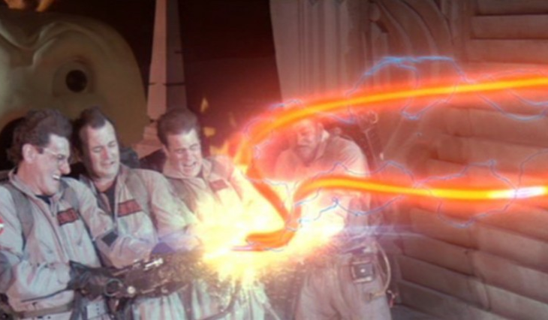
What is a loop?
A loop allows you to repeat a sequence of code.
Programs spend the vast majority of their execution time in loops.
We will focus on structured loops: while, for, and do-while.
You can also create loops with goto: but don’t, it’s ugly.
Ghostbusters don’t cross streams, and good programmers don’t cross loops.

Slide 21
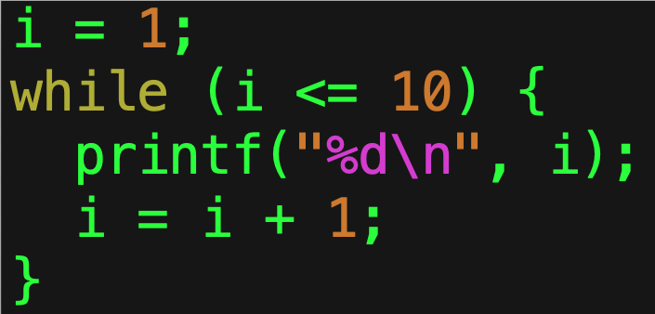
while ()
It is called a top-test loop
The test is evaluated before entering the loop.
Executes the statement as long as the Boolean condition remains true.
Executes the statement zero or more times.

Slide 22
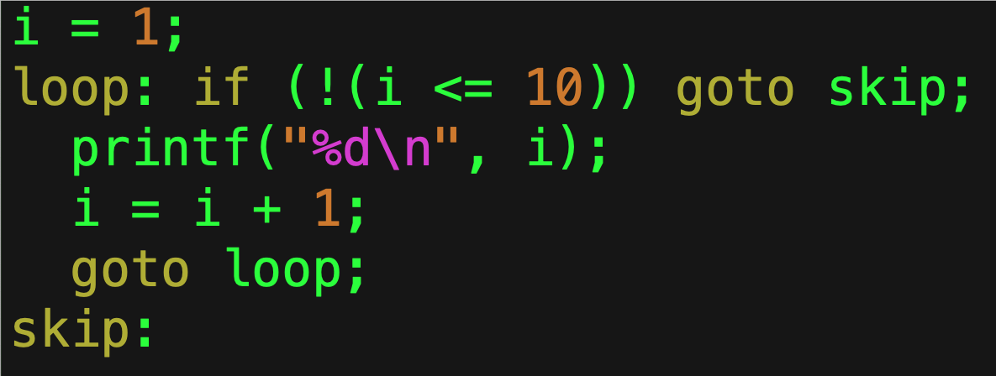
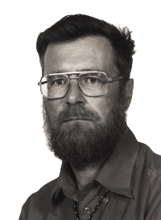
Equivalent goto Code
You can implement it with the goto statement.
Just because you can does not mean that you should.
I warned you about this in 1968!

Slide 23
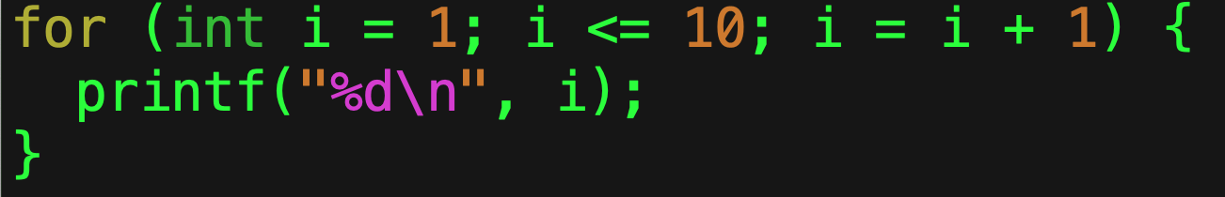
for ()
Also a top-test loop.
Puts:
Initialization,
Test, and
Increment all together.
By convention they are related, but nothing in C requires them to be.
Deze code is veel beter leesbaar!
Notes:
Dijkstra: “This code is much more readable!”

Slide 24
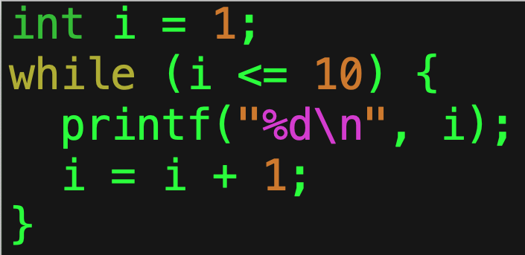
Equivalent while()
This is the equivalent while statement.
The while statement is complete
Which means you can implement any loop using it.
The Böhm-Jacopini theorem proves you can do it all with while!

Slide 25
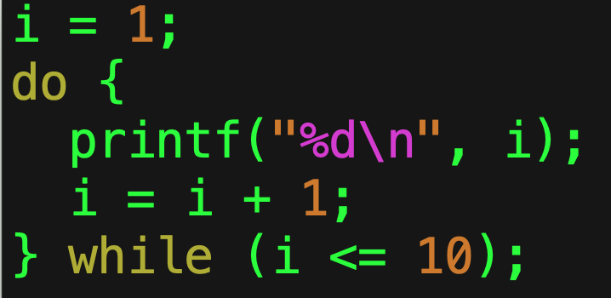
do { } while ()
This is a bottom-test loop.
Used when you want to perform the statement at least once.
Continues to execute the enclosed statement as long as the Boolean condition remains true.

Slide 26
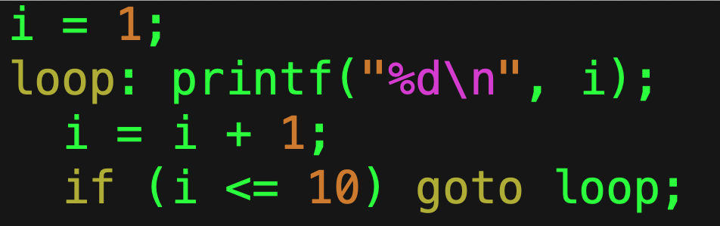
Equivalent goto Code
This is the equivalent code using goto.
You should never write code like this unless your programming language lacks the equivalent statement.

Slide 27
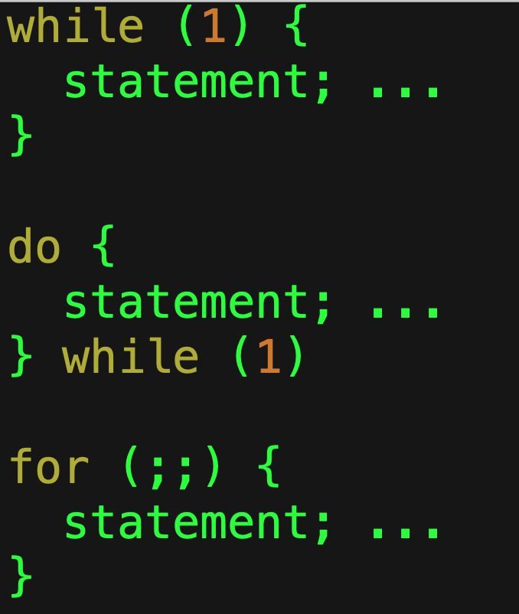
Infinite Loops
All of these execute forever.
The one you choose is a matter of style, not of substance.
How do you ever escape?
Use the break statement.

Slide 28
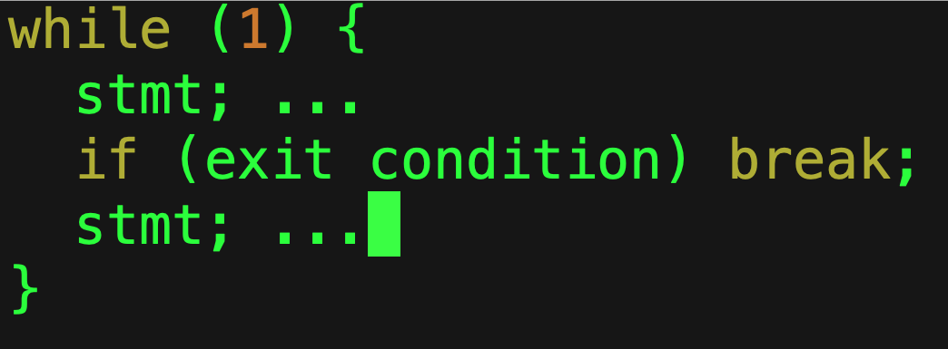
break
Immediately exits the enclosing loop.
Allows for middle-exit loops.
This is still considered structured programming, but it should be used in moderation.

Slide 29
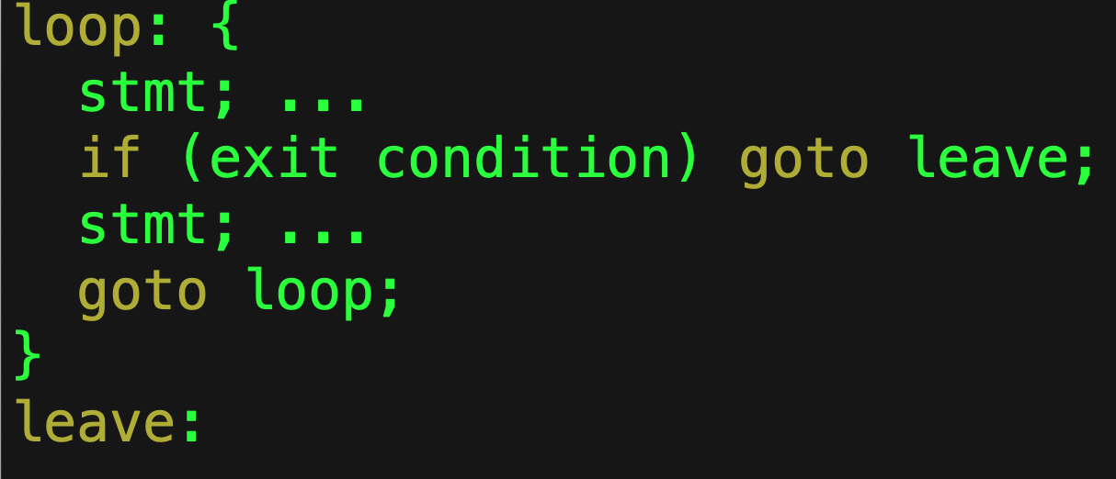
Equivalent goto Code
It goes without saying that you should not write code like this…

Slide 30
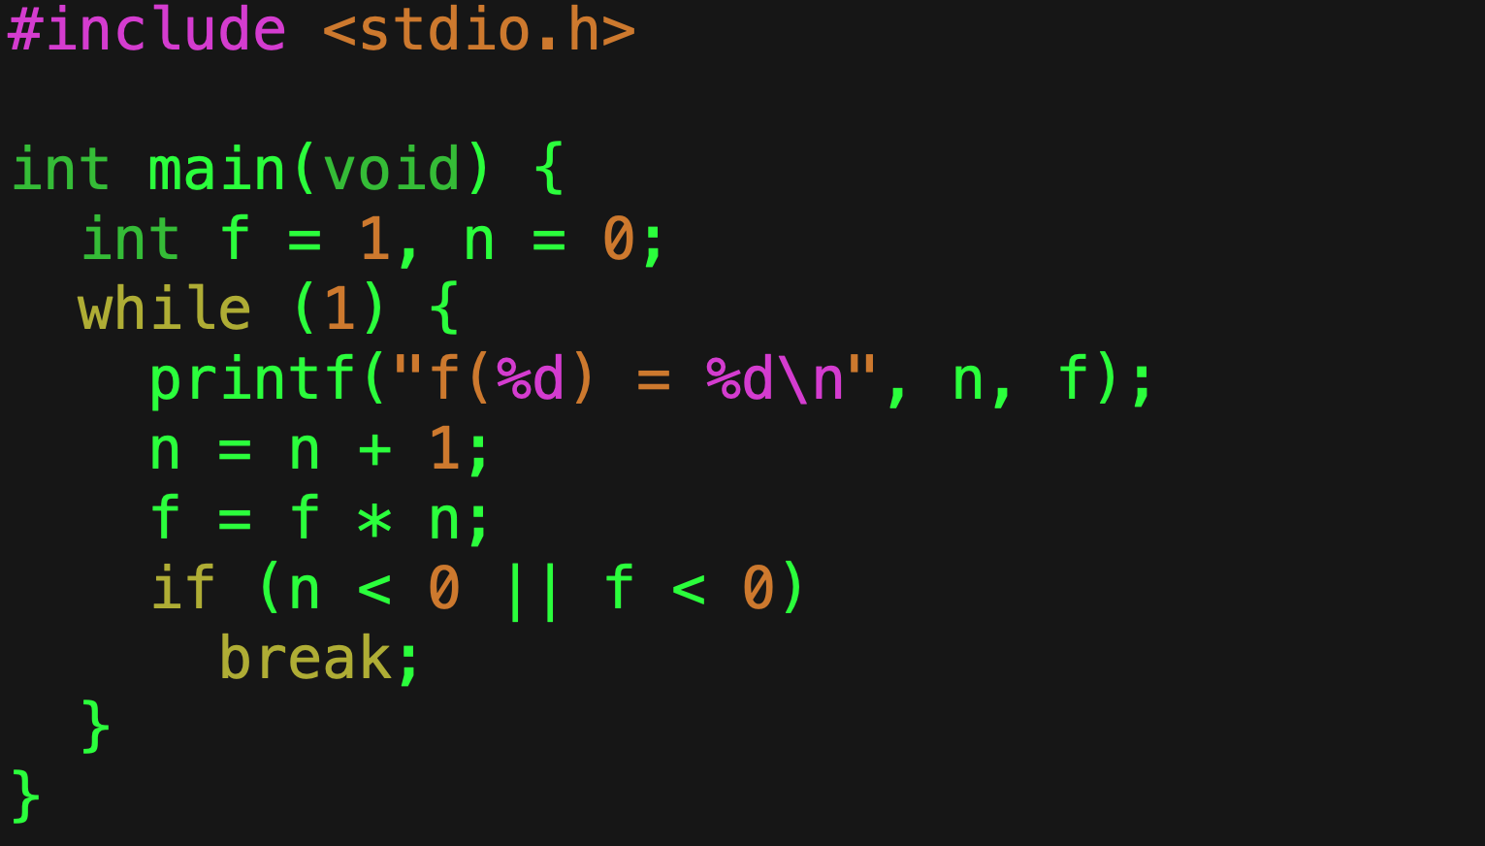

Factorial Example
$n!=n × \left(n−1\right)!$
This code will print from $0!$ to the largest that will fit in an int.
We use the fact that numbers are stored in two’s complement (and so turn negative when they exceed the positive numbers).
We are trying to be perhaps a bit too clever.
Our attempt at cleverness
Notes:
Do not try to be clever. This only stops because ints have limited precision and flip over into negative territory because of two’s complement arithmetic.

Slide 31
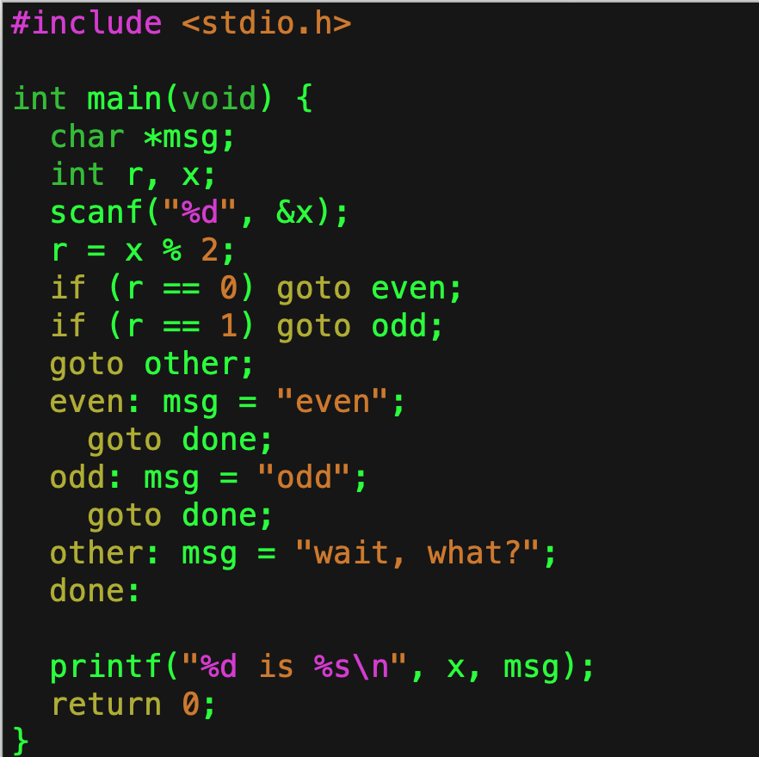
goto
If you use goto then you are a failure at programming!
This is an equivalent program.
Can you see the need for break?
This kind of programming is considered very bad form.

Slide 32
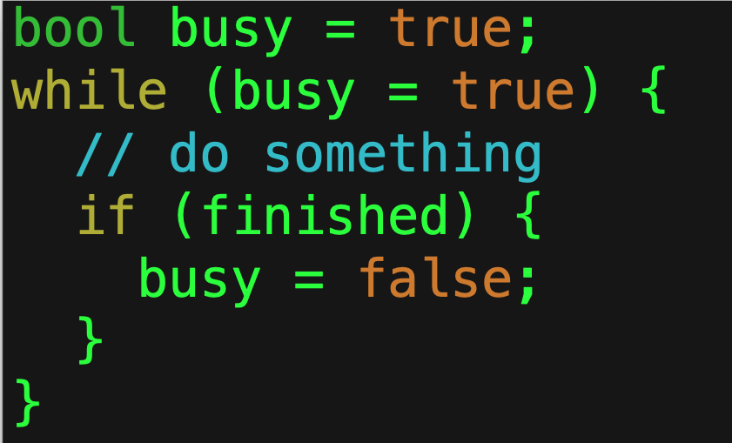
What’s wrong with this code?
This!
It’s an infinite loop!
How do I know that?
Never forget that
= is assignment and
== is equality!

Slide 33
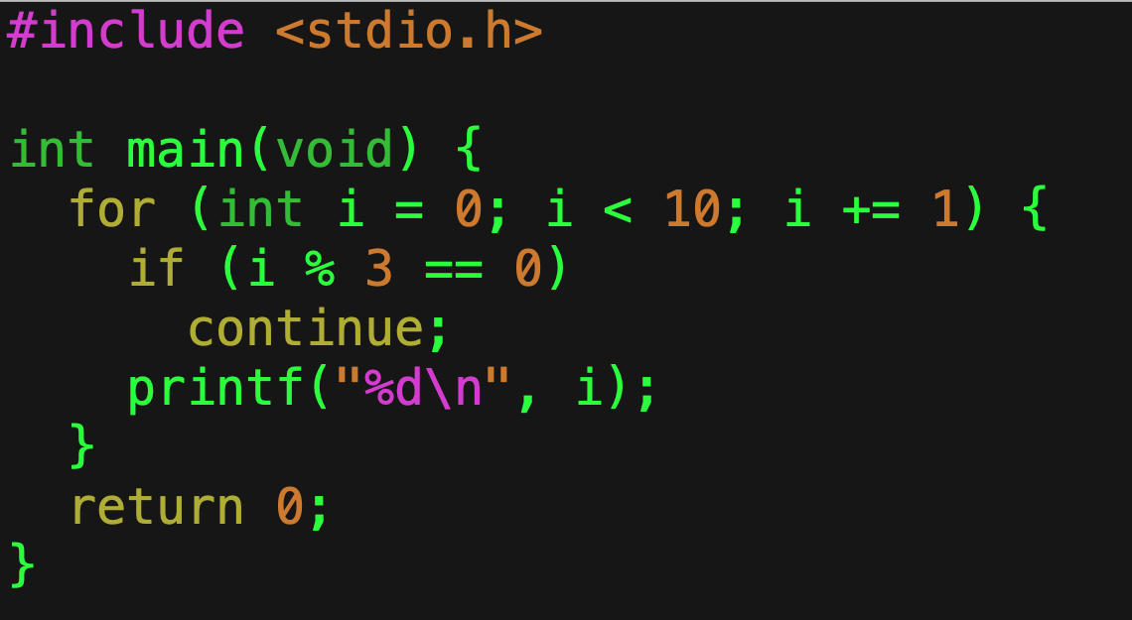
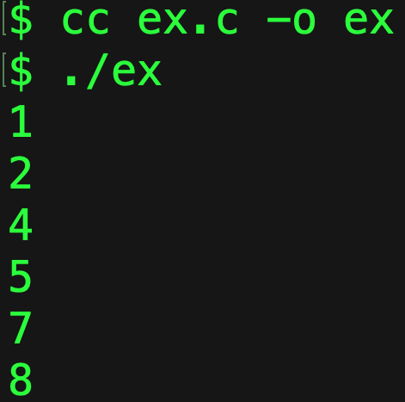
continue
You may have times when you want to skip the remainder of a loop.
For this, there is continue.
Please use it sparingly.

Slide 34
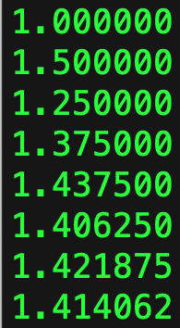
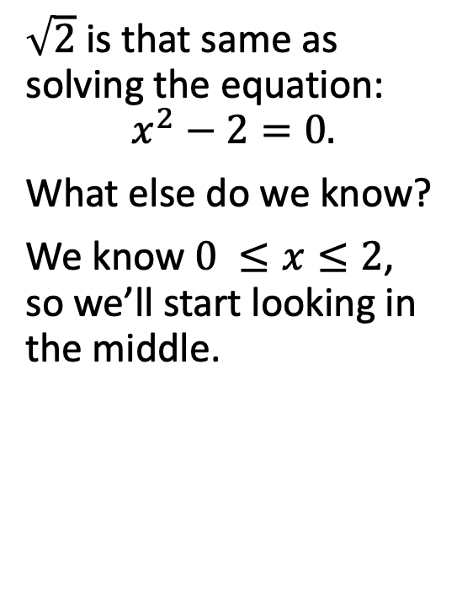
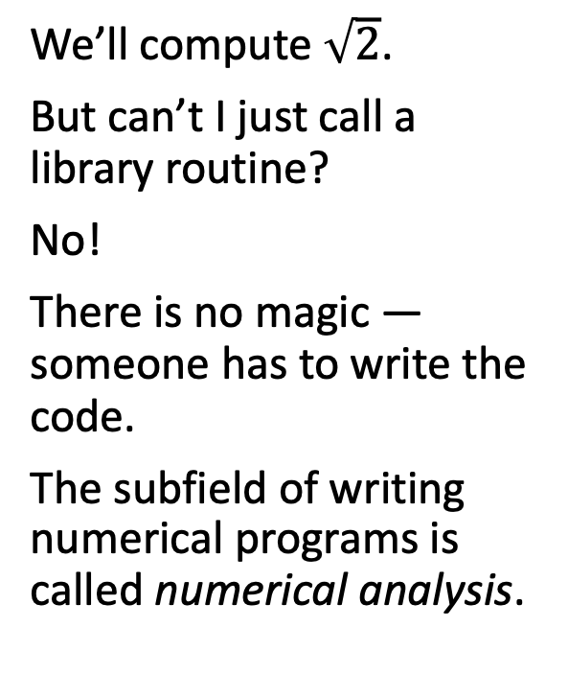
Let’s Compute!
We’ll compute $\sqrt{2}$.
But can’t I just call a library routine?
No!
There is no magic — someone has to write the code.
The subfield of writing numerical programs is called numerical analysis.
$\sqrt{2}$ is that same as solving the equation:
$$x^{2}−2=0.$$
What else do we know?
We know $0 ≤x≤2$, so we’ll start looking in the middle.
$\sqrt{2}≈$1.414213562373095048801688724209698078569671875376948073

Slide 35
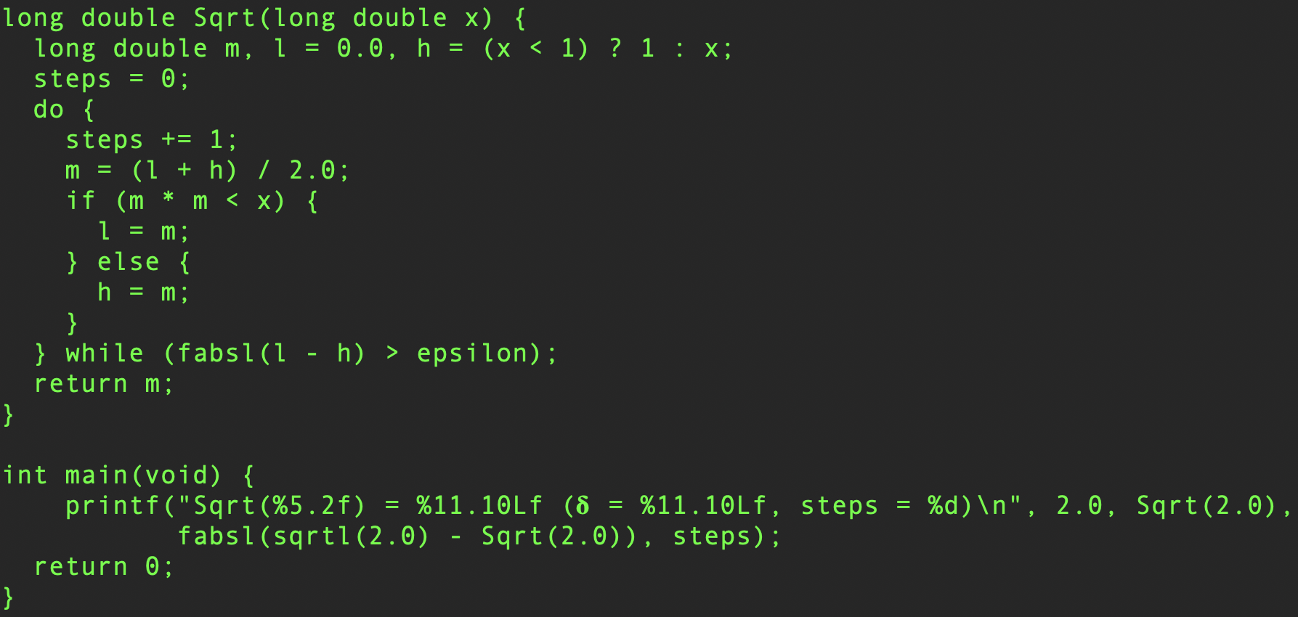
Bisection Method

Slide 36
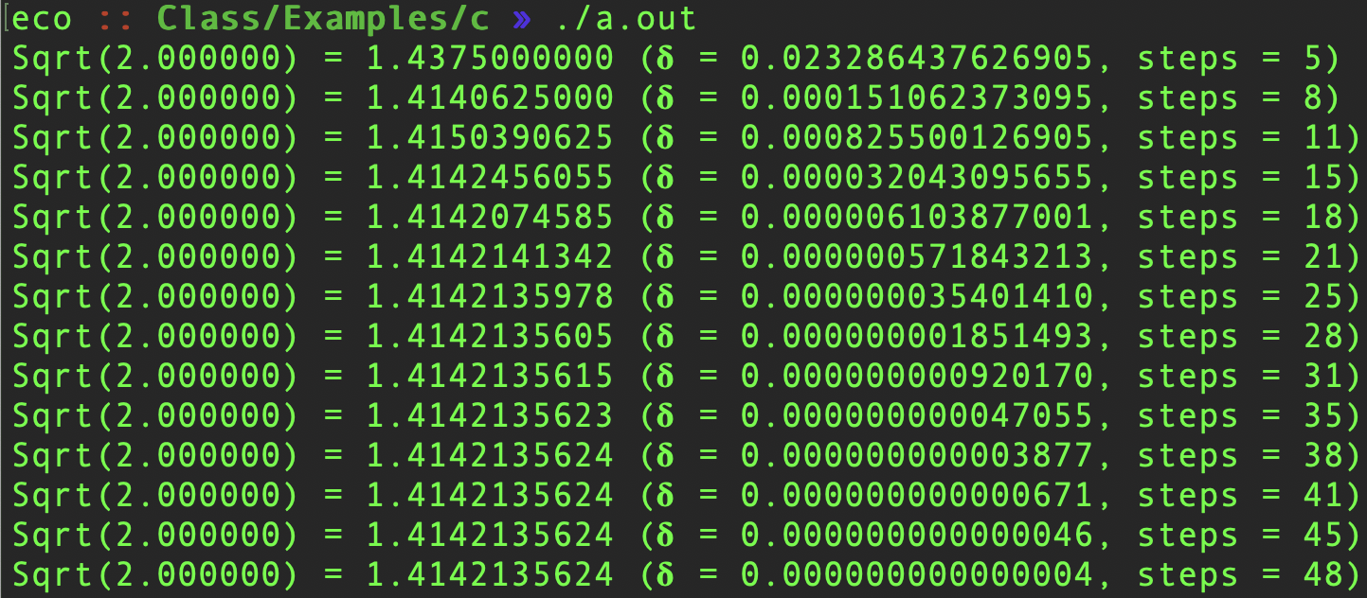
How long does it take?

Slide 37
Summary
Boolean logic is a branch of mathematics dealing with just two values: true and false.
C uses 0 for false, and non-zero for true.
Short-circuit evaluation allows an expression to be determined as soon as possible.
if (expression) statement
Executes the statement if the expression is non-zero.
else statement
Executes if the if expression was zero.
switch (value) selects cases correspond to the value.
goto jumps to a label.
Do not use it without a very good reason.
for and while are top-test loops.
do-while is a bottom-test loop.
break breaks out of enclosing loop or terminates a single switch-case statement.
continue continues to the next iteration of the enclosing loop.

